Slide 1
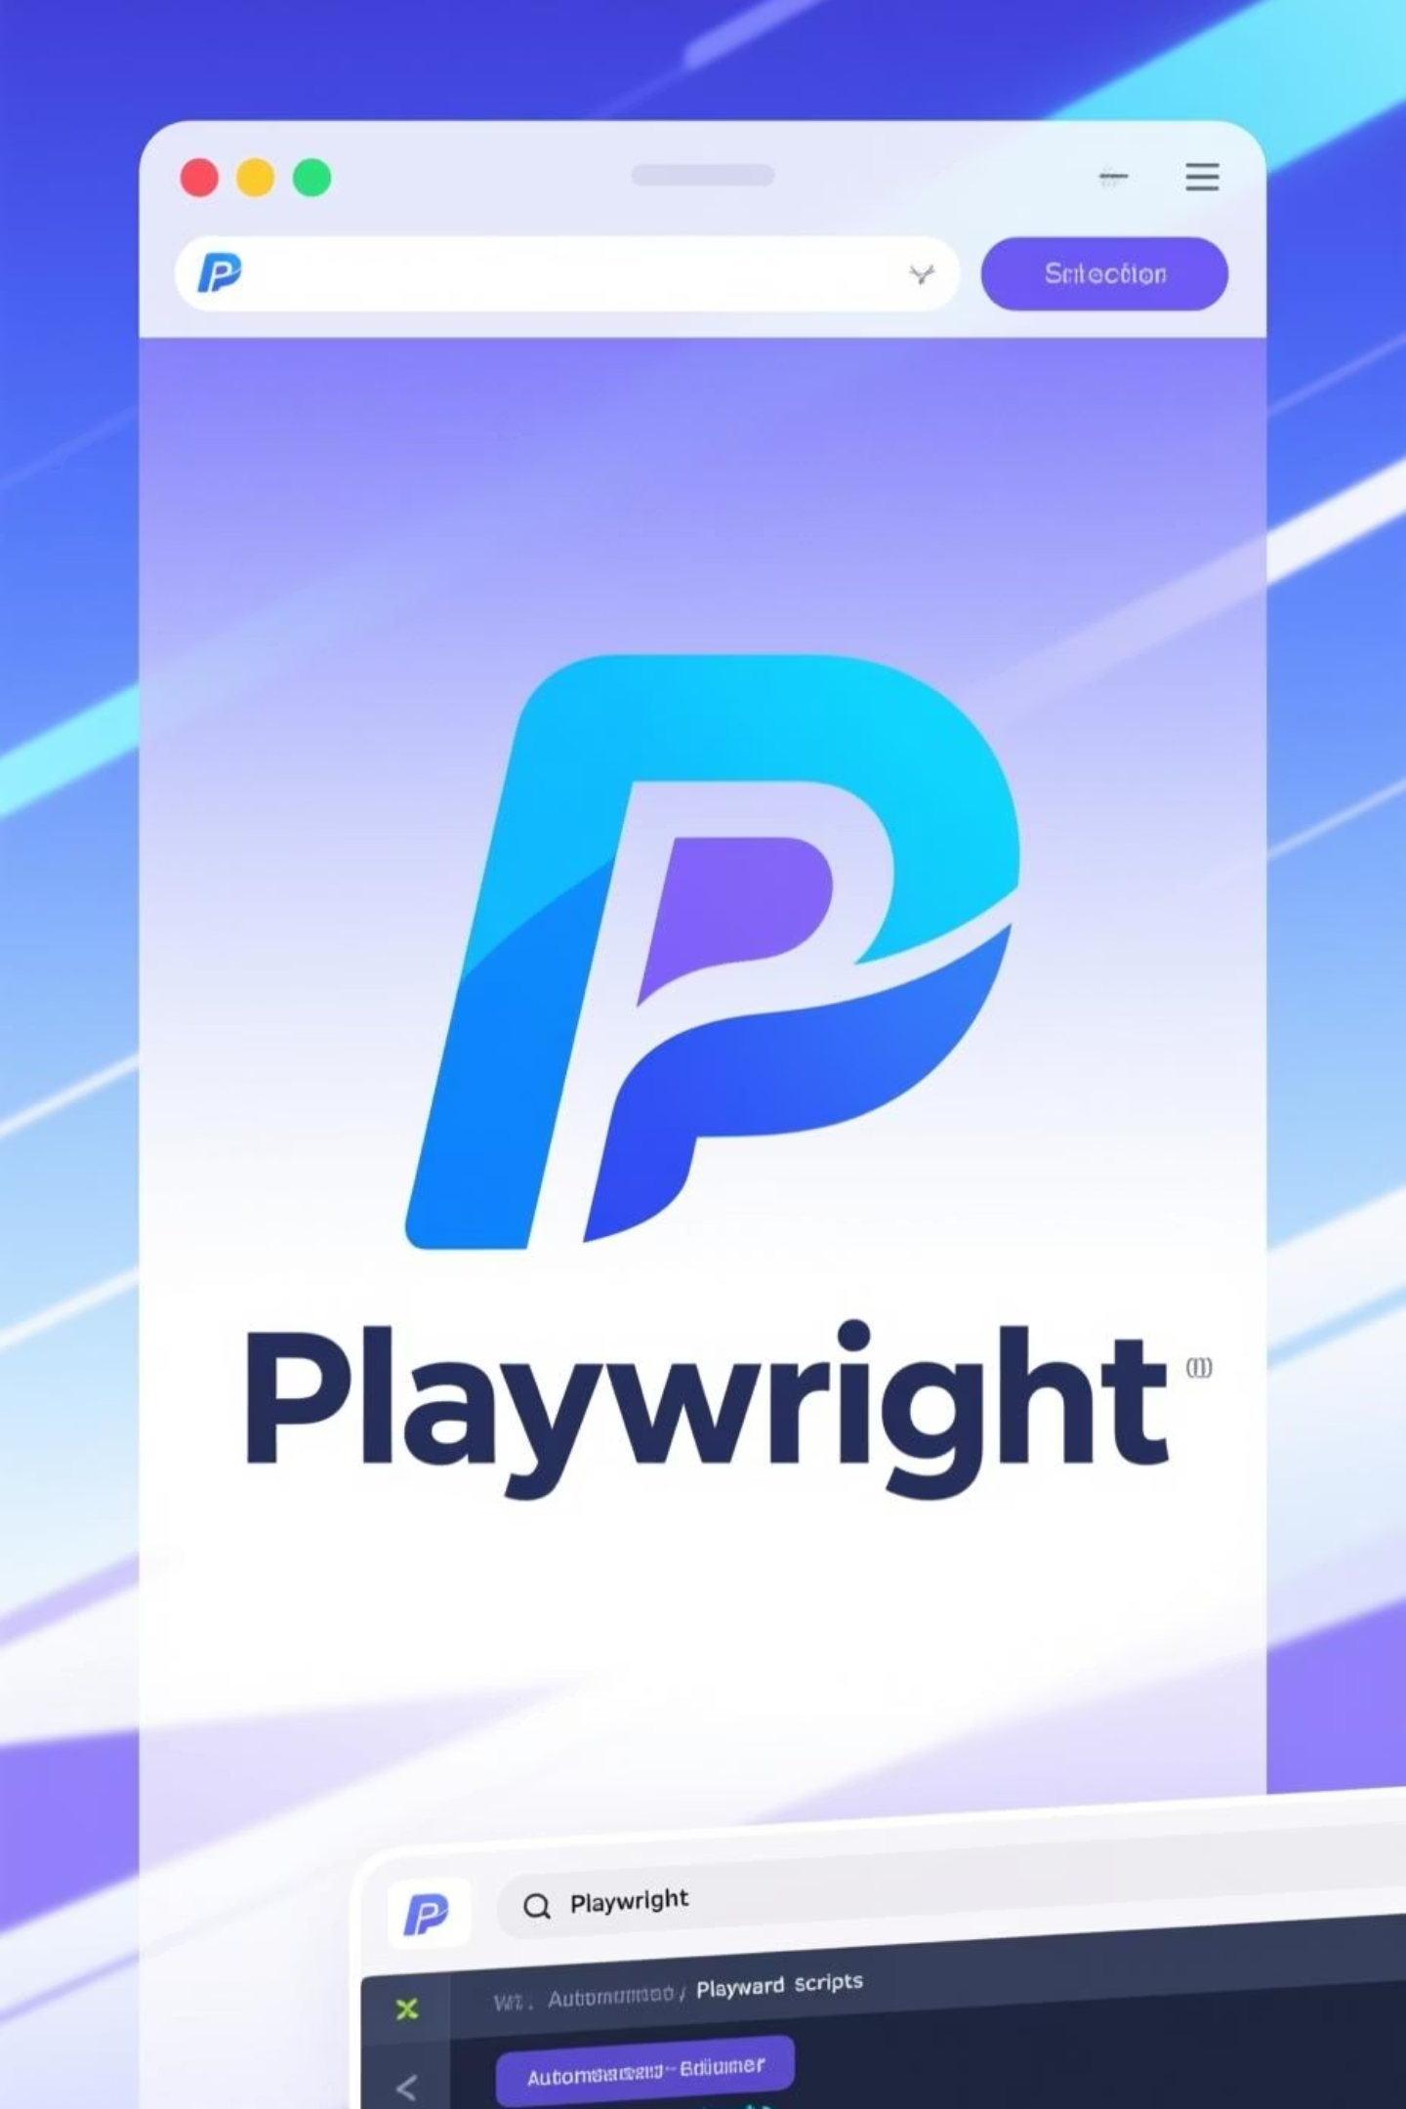
Playwright
Modern End-to-End Testing Framework
Presented by SINDUJA S
November 25, 2025

Slide 2





Modern Testing Challenges
Flaky Tests
Slow Execution
Cross-Browser Issues
Inconsistent results that reduce confidence in test reliability
Long test runs delaying feedback and deployments
Inconsistencies across browsers and devices
Complex Debugging
Testing Silos
Difficult to diagnose and fix test failures
Lack of integration between UI and API testing

Slide 3
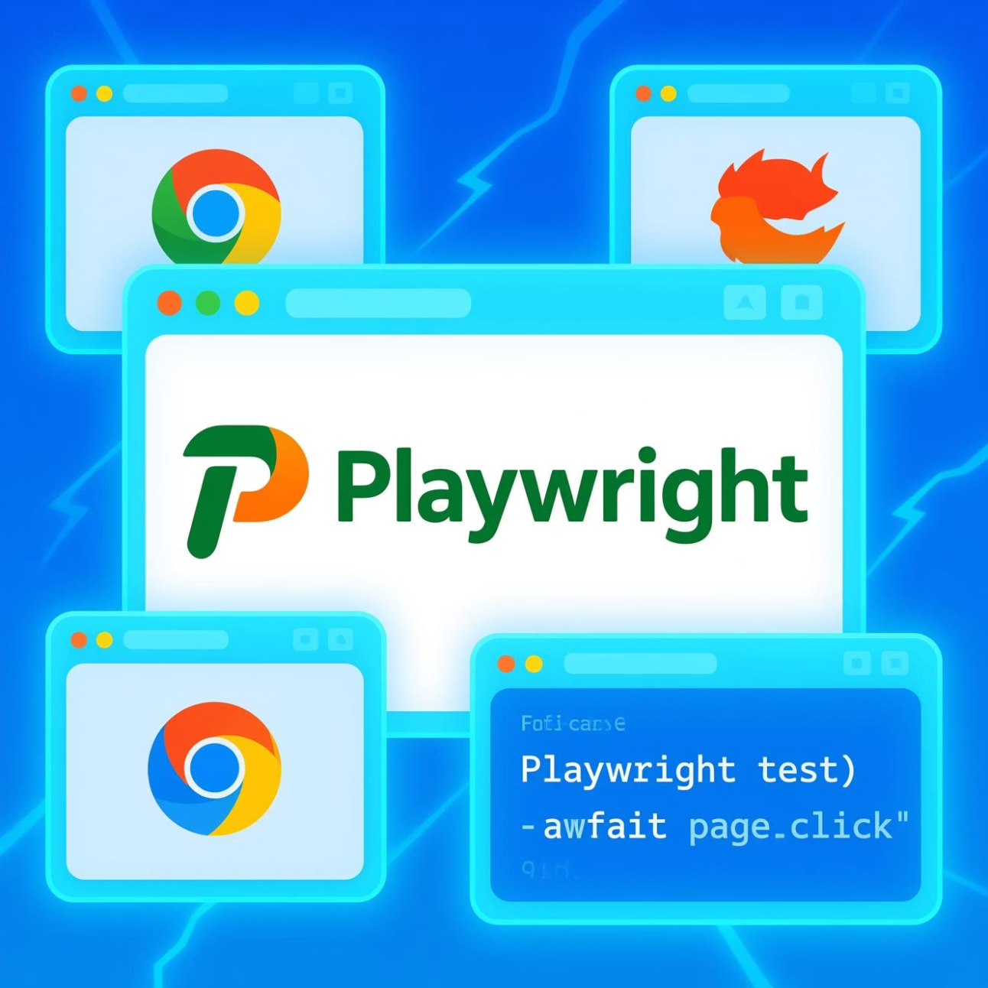
What is Playwright?
Modern end-to-end automation framework
Created by Microsoft in January 2020
Automates web applications across major browsers
Supports both UI and API testing
01
02
Fast
Reliable
Parallel execution reduces runtime significantly
Auto-waiting prevents flaky tests
03
Developer-Friendly
Easy to use, debug, and integrate

Slide 4





Why Choose Playwright?
Auto-Waiting
Cross-Browser Support
Playwright waits for elements to be ready before interactions - fewer flaky tests
Test seamlessly on Chromium, Firefox, and WebKit
Faster Execution
Developer-Friendly
Runs tests in parallel by default, reducing total execution time.
Easy to use and debug

Slide 5
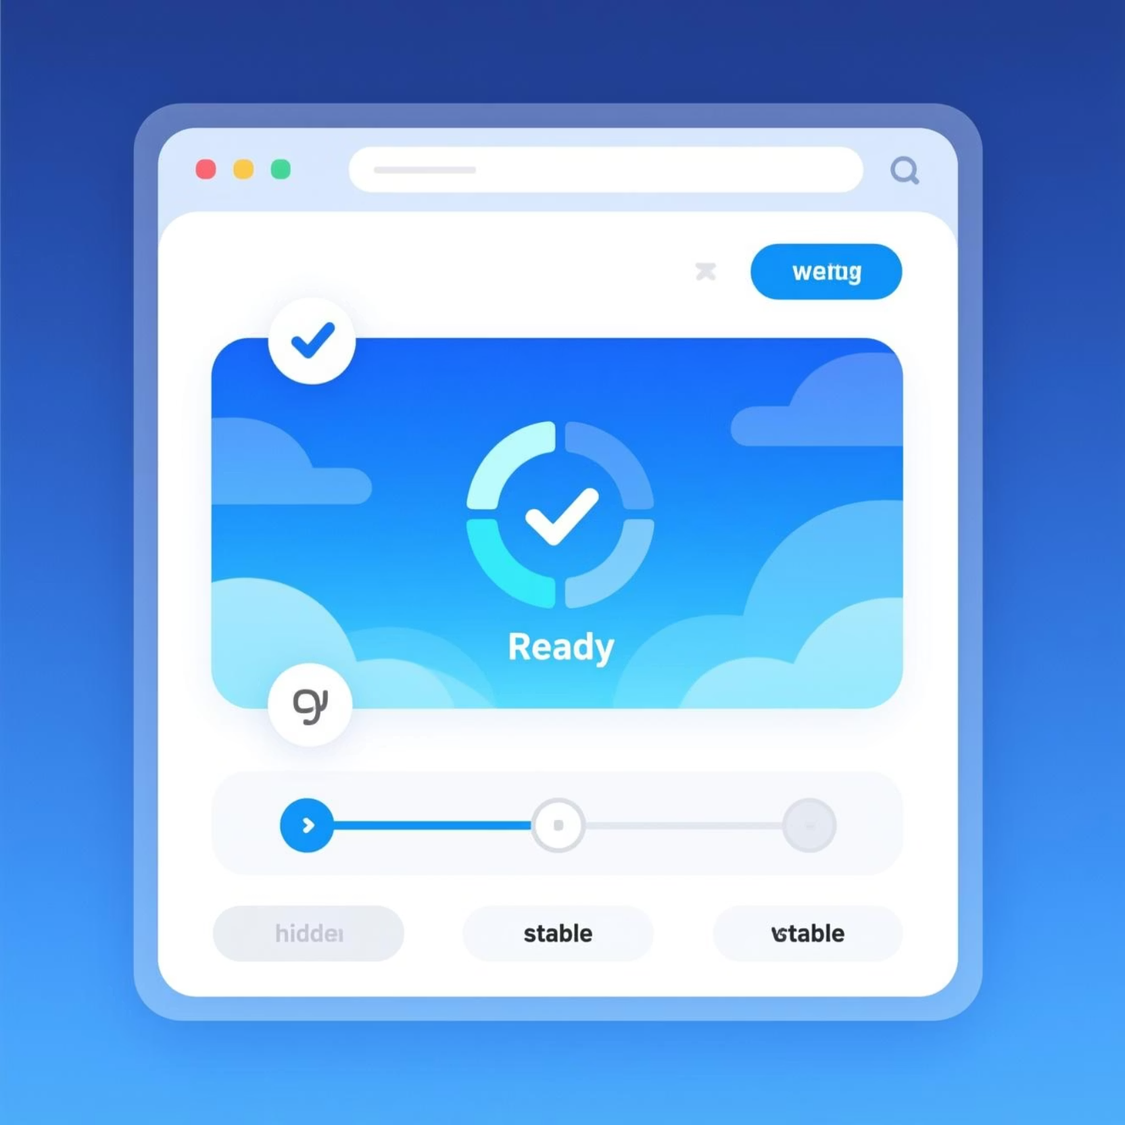
Auto-Waiting & Actionability
Intelligent Element Handling
Playwright automatically waits for elements to be visible, stable, and interactive before performing actions.
Prevents flaky tests caused by timing issues
Mimics real user behavior naturally
No manual waits or sleep commands needed

Slide 6
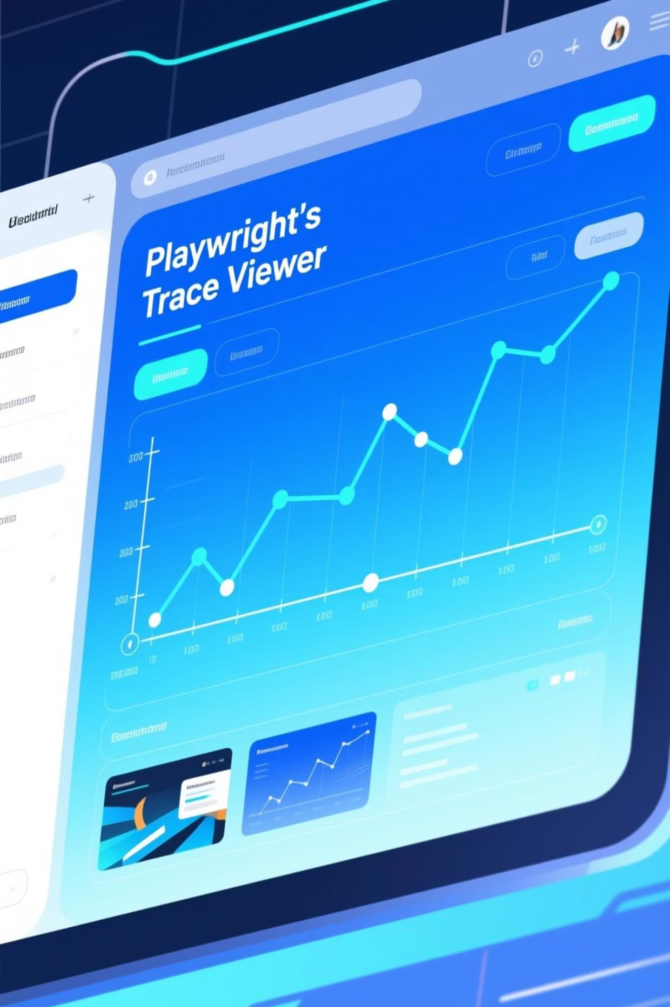



Powerful Debugging Tools
Screenshots
Capture before and after each step to visualize test execution and identify failures quickly
Video Recording
Record full test executions to replay and analyze failures in detail
Trace Viewer
Step-by-step debugging with replay capabilities and detailed execution traces

Slide 7
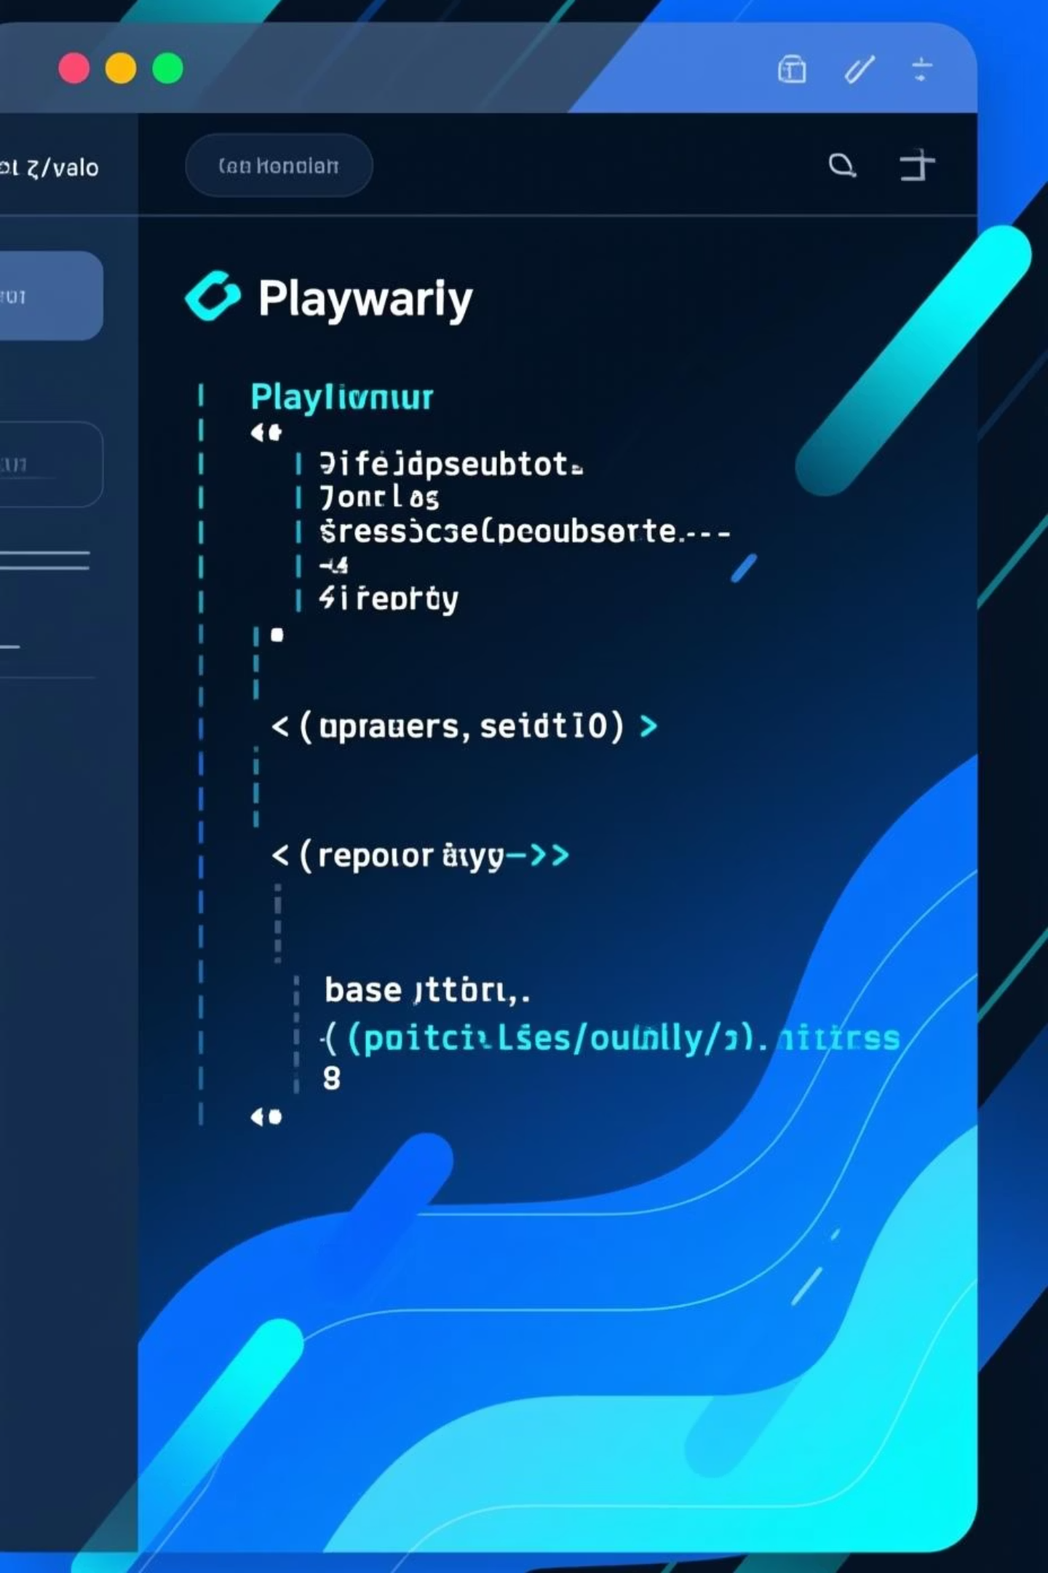
Lightweight Setup
Centralized Configuration
Manage all settings for browsers, retries, and parallel execution in one simple file.
Cross-Browser Setup
Easily define target browsers (Chromium, Firefox, WebKit) directly in the config.
Built-in Parallelism
Playwright runs tests in parallel automatically, maximizing efficiency without complex setup.
Flaky Test Retries
Configure automatic retries for tests prone to intermittent failures, improving stability.
Flexible Reporting
Integrate with popular test reporters like Allure and JUnit for comprehensive test results.
Base URL Management
Define a base URL in your config to avoid hardcoding URLs across all your tests.

Slide 8

Advanced Capabilities - Part 1
Browser Context Management
Multi-Language Support
Multi-Platform Testing
Creates multiple isolated browser contexts within a single browser instance.
JavaScript/TypeScript, Python, Java, and .NET compatibility
Windows, Linux, macOS, iOS/Android emulation
Each context acts like a separate incognito window with independent cookies, sessions, and storage.
Resource Efficiency: No need to launch new browsers for each test, saving resources and enabling multiple users to interact with the app simultaneously.

Slide 9

Advanced Capabilities - Part 2
Codegen Tool
Parallel Execution
CI/CD Integration
Record user actions and generate test scripts automatically
Run tests in parallel across multiple workers by default
Seamless integration with modern deployment pipelines
Great for beginners
Network Interception
Mock API responses, simulate network errors, and control network traffic for stable testing

Slide 10
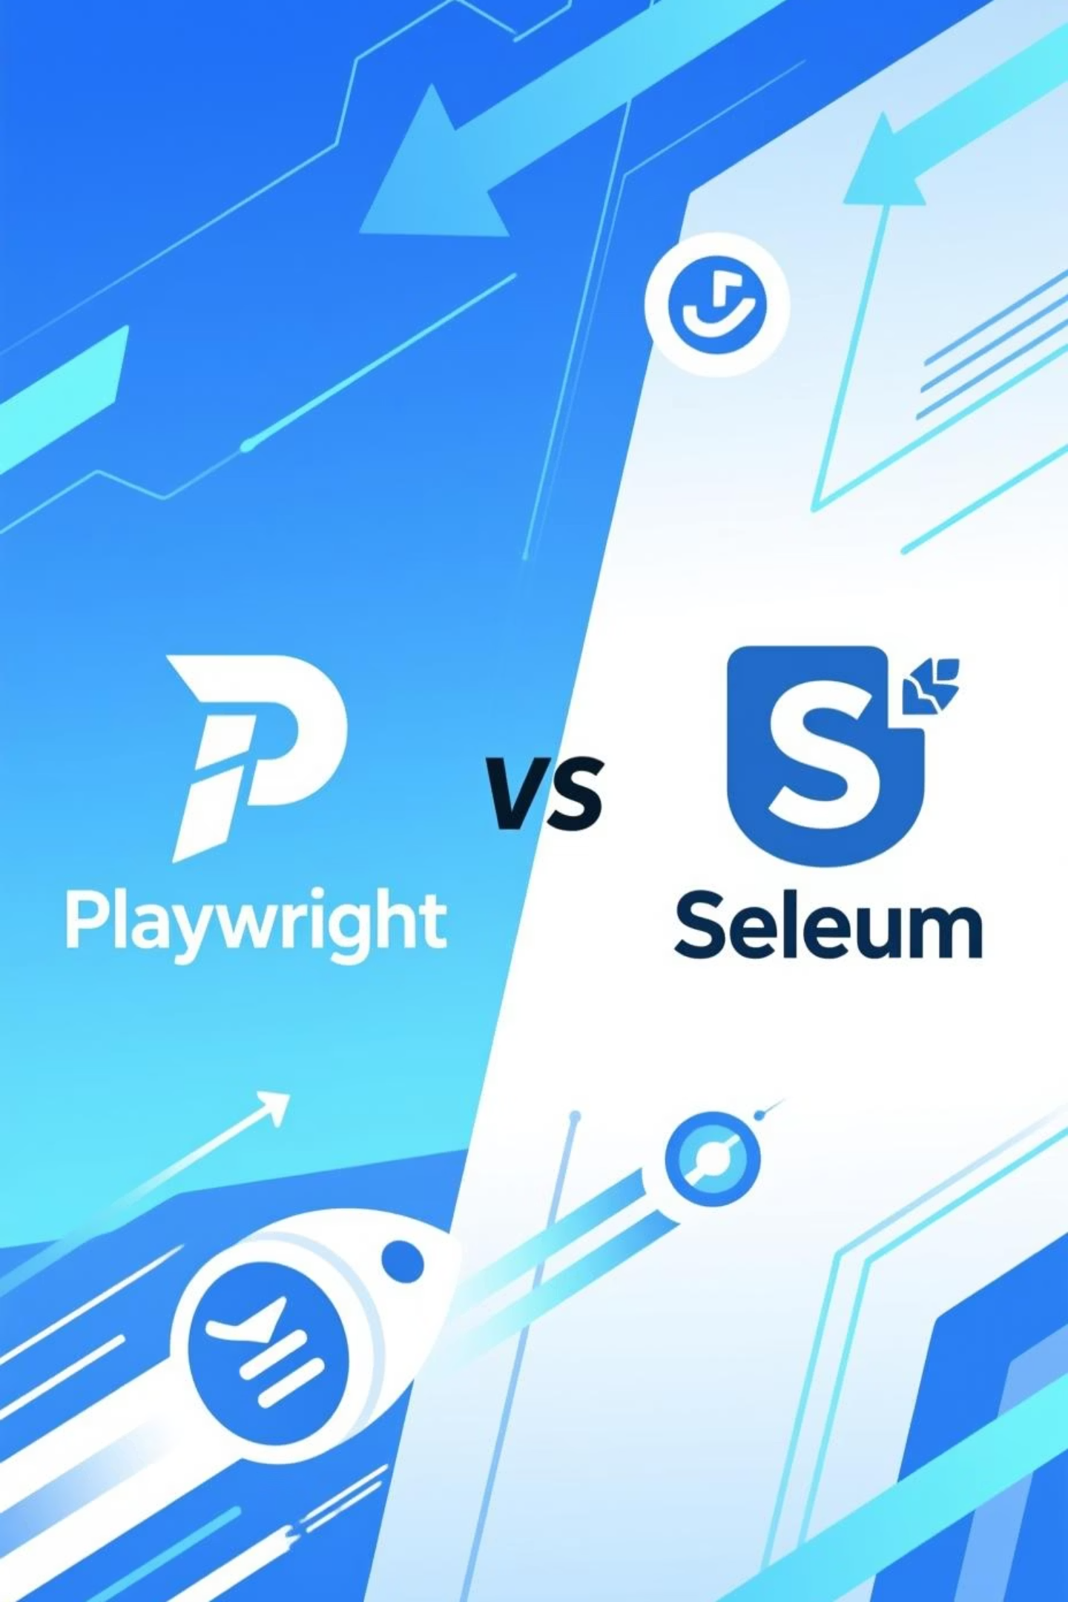
Playwright vs Selenium
Feature
Playwright
Selenium
Speed
Very fast (parallel by default)
Slower unless manually parallelized
Cross-Browser Support
Chromium, Firefox, WebKit
Chrome, Firefox, Safari, Edge
Auto-Waiting
Built-in (no flakiness)
Manual waits needed (prone to flakiness)
API Testing
Native support
Requires additional tools
Debugging Tools
Trace viewer, screenshots, videos
Limited built-in tools
Playwright offers a modern, comprehensive solution for end-to-end testing with superior speed, reliability, and developer experience.

Slide 11
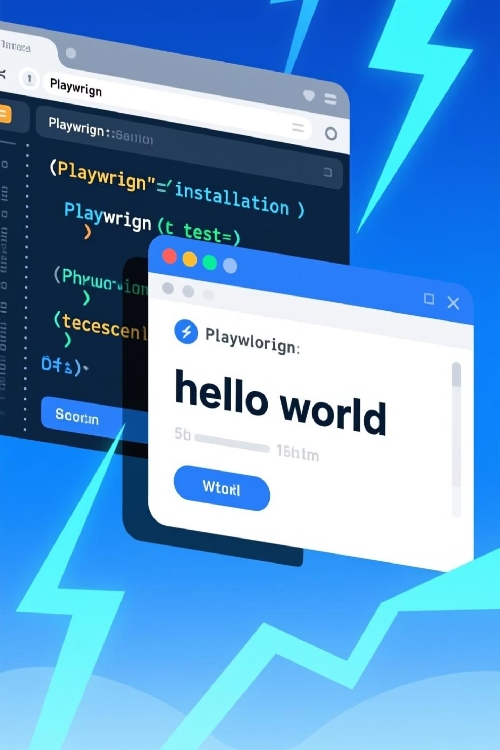
Getting Started with Playwright
01
Prerequisites
Ensure Node.js is installed on your system:
Download from nodejs.org (LTS version recommended)
Verify installation: node --version and npm --version
Minimum Node.js version: 16 or higher
02
Installation
Set up Playwright in your project:
npm init playwright@latest
This command guides you through configuration.
03
Basic Setup
A default configuration file playwright.config.ts is created. You can customize settings like browser types, timeouts, and reporters here.
Run your tests with:
npx playwright test
04
Resource
Dive deeper into Playwright's capabilities:
Official Documentation

Slide 12
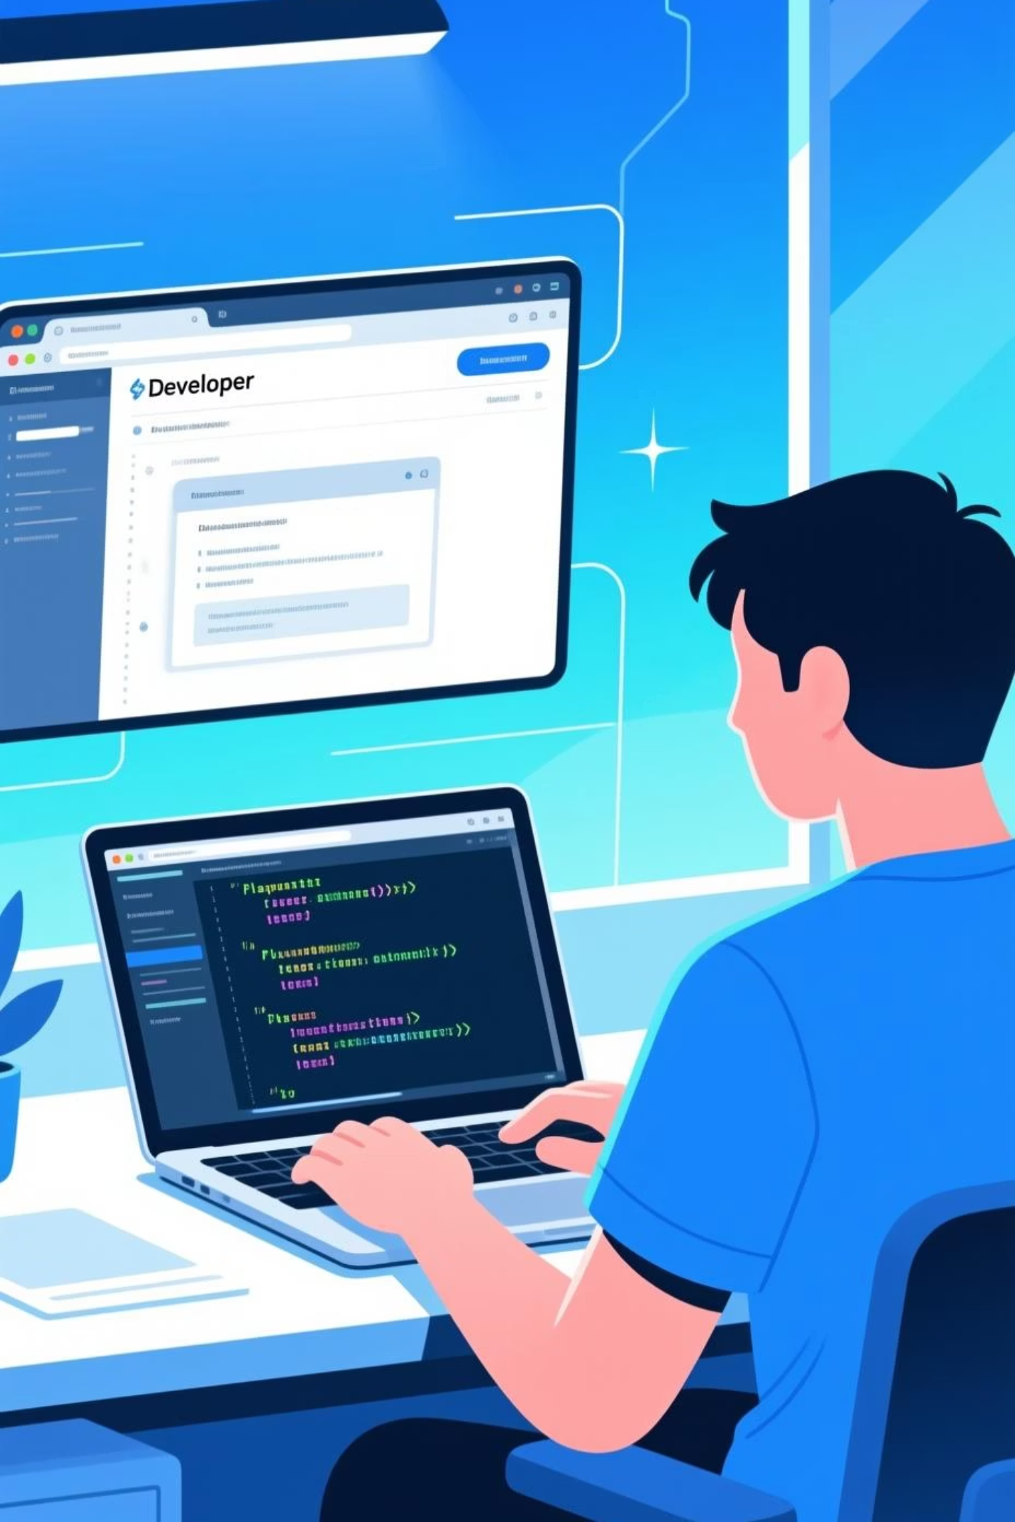
How to Automate One Test in Playwright (Step-by-Step)
01
Inspect Element
Use browser dev tools to find the element (Right-click → Inspect → Copy selector)
02
Choose Locator
Use a smart locator: getByText(), getByRole(), etc.
03
Write Action
Click, fill, type, etc.: await page.click('button');
04
Add Assertion
Verify the expected behavior: expect(page).toHaveText('Success');
05
Run Test
Use npx playwright test to execute the script
06
Debug
Check video, screenshot, or trace for failures

Slide 13
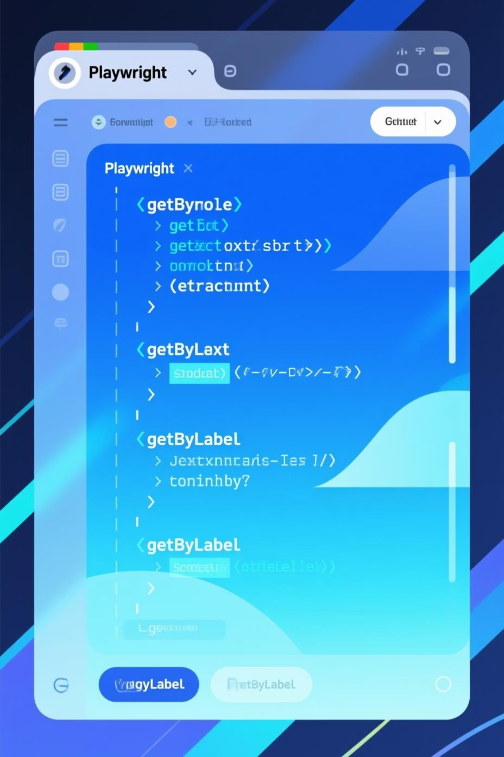
Best Practices for Locators in Playwright
Preferred Locators
Avoid Brittle Locators
getByRole(): Best for accessibility and mimicking user interaction
Minimize the use of highly specific CSS selectors (getByCss()) or XPath (getByXPath()) that are prone to breaking with UI changes. Prioritize semantic locators.
getByText(): Ideal for static, visible content
getByLabel(): Perfect for forms and input fields
Auto-generated Locators
Mimic User Actions
Playwright's Codegen tool can automatically generate resilient locators, making it easier to start and maintain tests.
Always choose locators that reflect how a real user would interact with the page, focusing on roles, labels, and visible text content for more stable and readable tests.

Slide 14
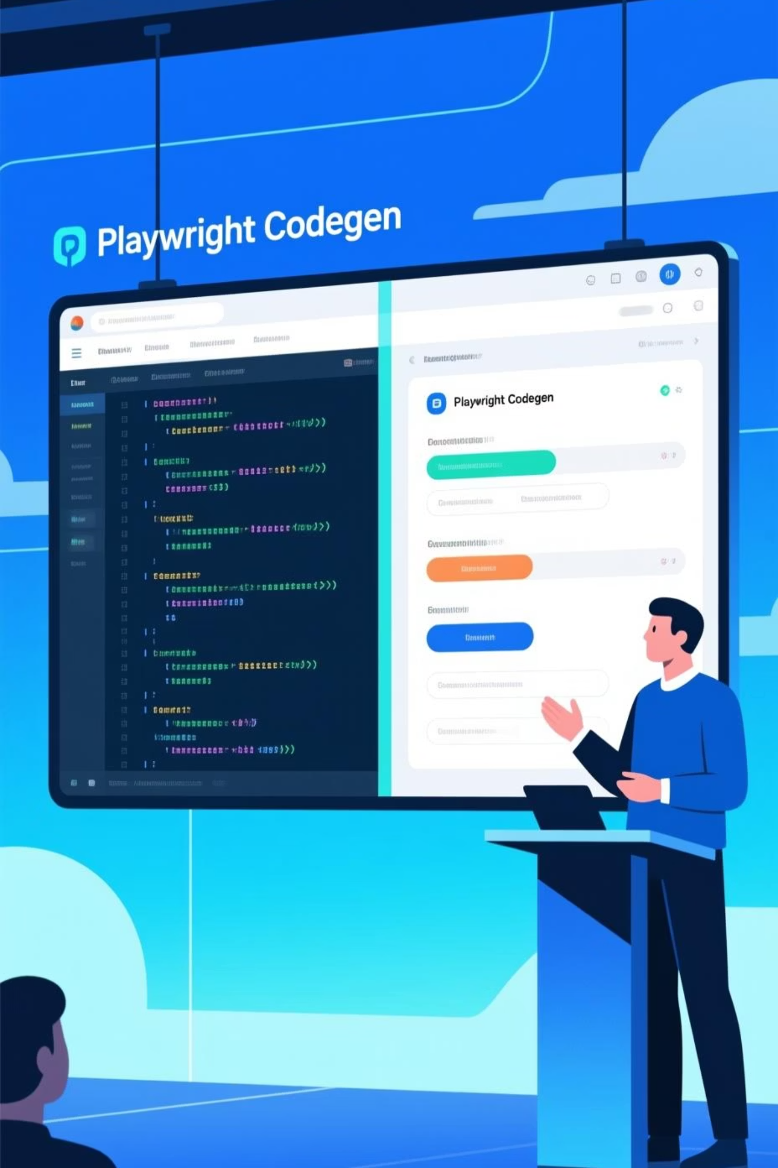



Live Demonstrations
Demo 1: Quick Script Generation
Open Codegen tool, interact with a web app, and generate test scripts automatically
Demo 2: Running a UI Test
Execute a login test in both headed and headless modes with video/screenshot results
Demo 3: Trace Viewer Debugging
Run a failing test, open Trace Viewer, and replay step-by-step to diagnose issues

Slide 15

Questions?
Thank You for Your Attention!

